Slide 1
THREE FREEDOMS CORNER
William & Caroline Streets
Fredericksburg Virginia
June 10, 2026
R. Kravetz

Slide 2
Religious Freedom 1777
Self-Emancipation 1862-3
Desegregation 1960

Slide 3
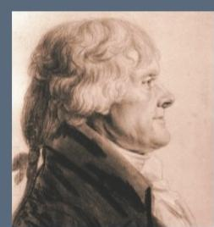
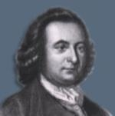
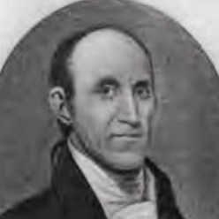
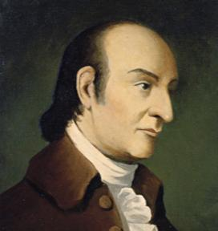
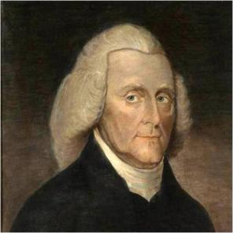
Thomas Jefferson
George Mason
Thomas Ludwell Lee
January 13-17, 1777
House of Burgesses
Committee of Revisors
Fredericksburg Virginia
George Wythe
Edmund Pendleton

Slide 4
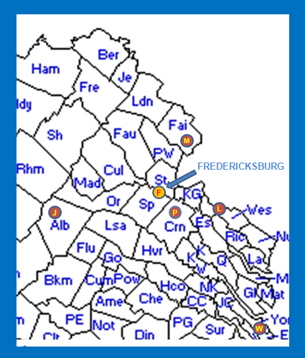
Where they came from:
Jefferson – Albemarle
Mason – Fairfax
Lee – Westmoreland
Pendleton – Caroline
Wythe – Williamsburg
…and met in Fredericksburg as a central location, away from the busy capital of Williamsburg

Slide 5
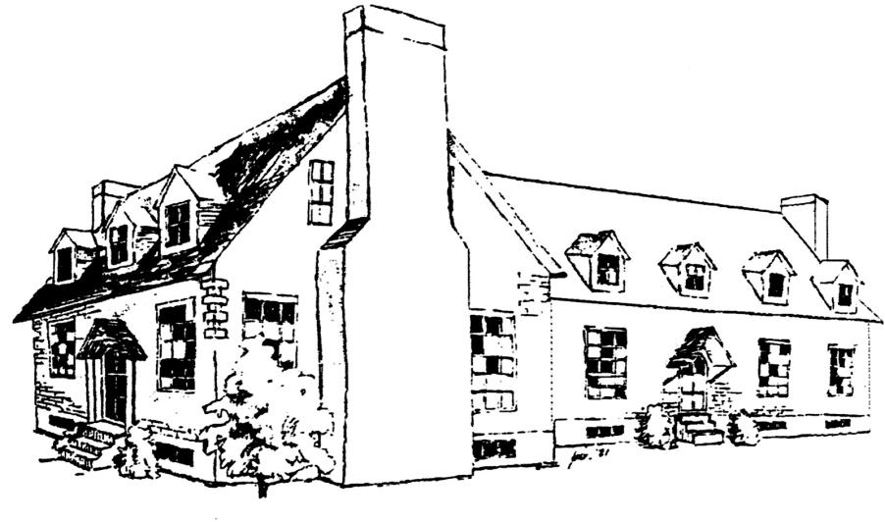
This drawing was based on the following plat, which showed the foundation of George Weedon’s Tavern, and was the basis for Cliff Sattherthwaite’s 2001 painting.

Slide 6
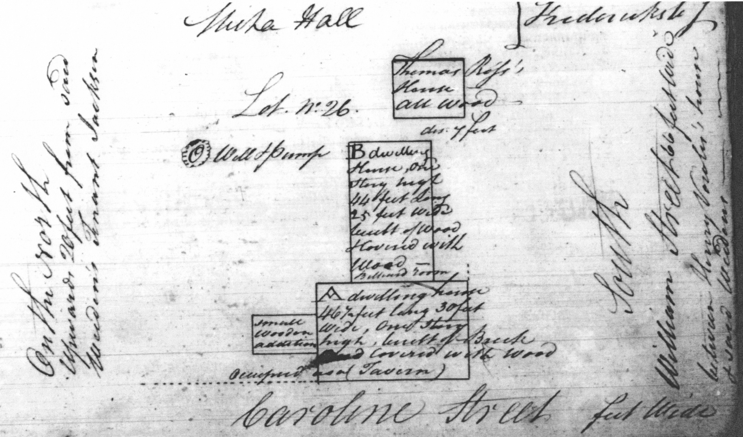
PLAT (Something) Hall
Left : “On the North upwards 20 feet from same Weedon’s Tenant Jackson”
Right : “South, William Street 66 feet wide between Henry North’s (??) home & said Weedon’s”
Top: “Thomas Ross’s house – all wood” “dis: 7 feet” “Well & pump”
“B dwelling House – one story high 44 feet long 25 feet wide built of wood floored with wood – billiard room”
“A dwelling house 46½ feet long 30 feet wide, one story high, built of Brick and (?) Covered with Wood occupied as a (Tavern)” Left: “small wooden addition”

Slide 7
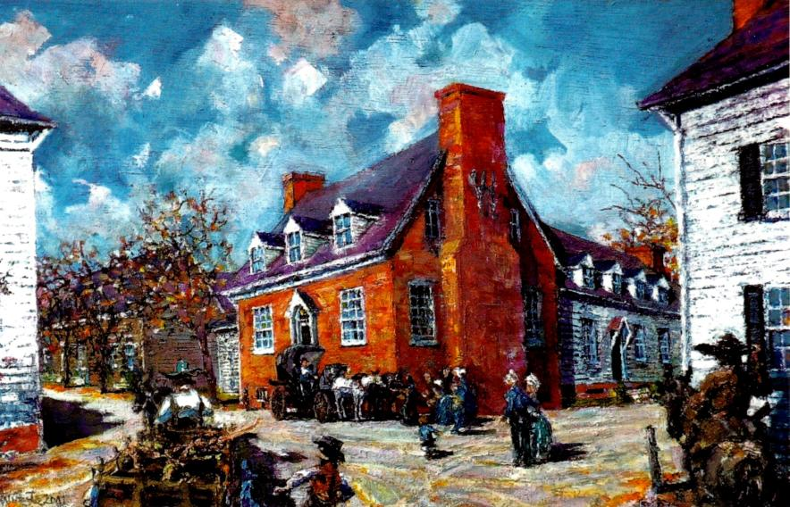
Weedon’s Tavern, January 13-17, 1777
Cliff Satterthwaite, 2001

Slide 8
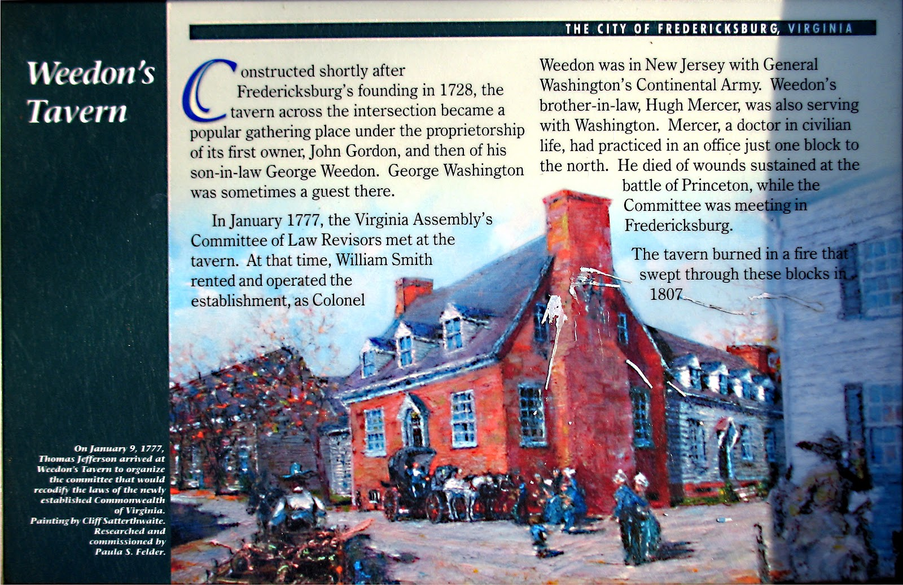
Original 2002 historic sign at William and Caroline Streets

Slide 9
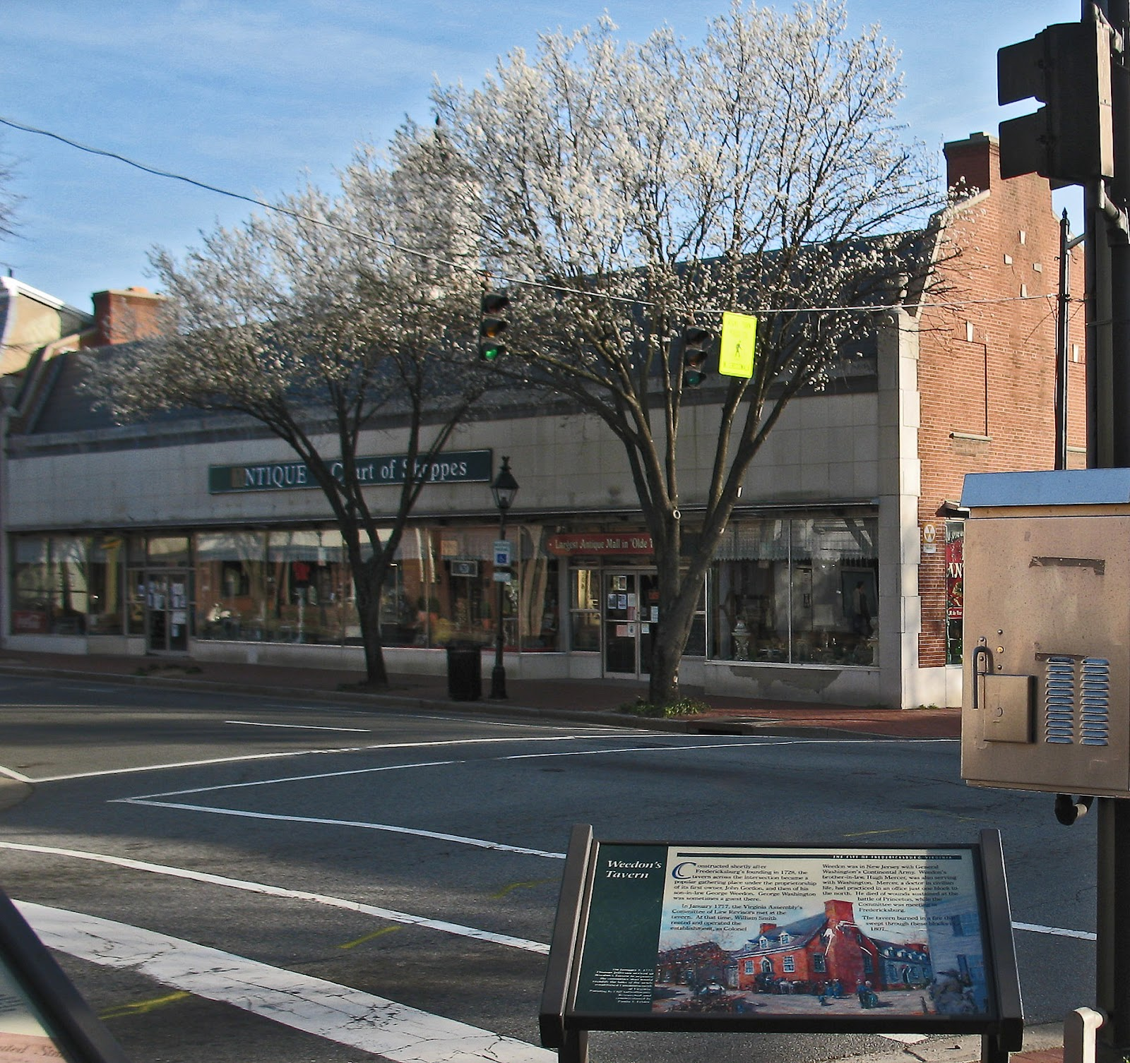
Site of Weedon’s Tavern, William and Caroline Streets

Slide 10
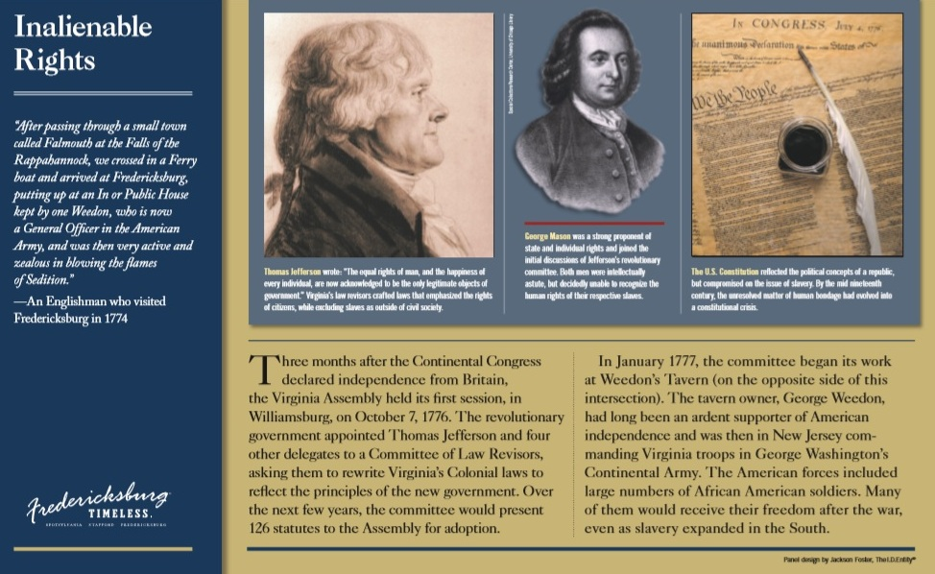
This replacement panel was installed in 2015

Slide 11
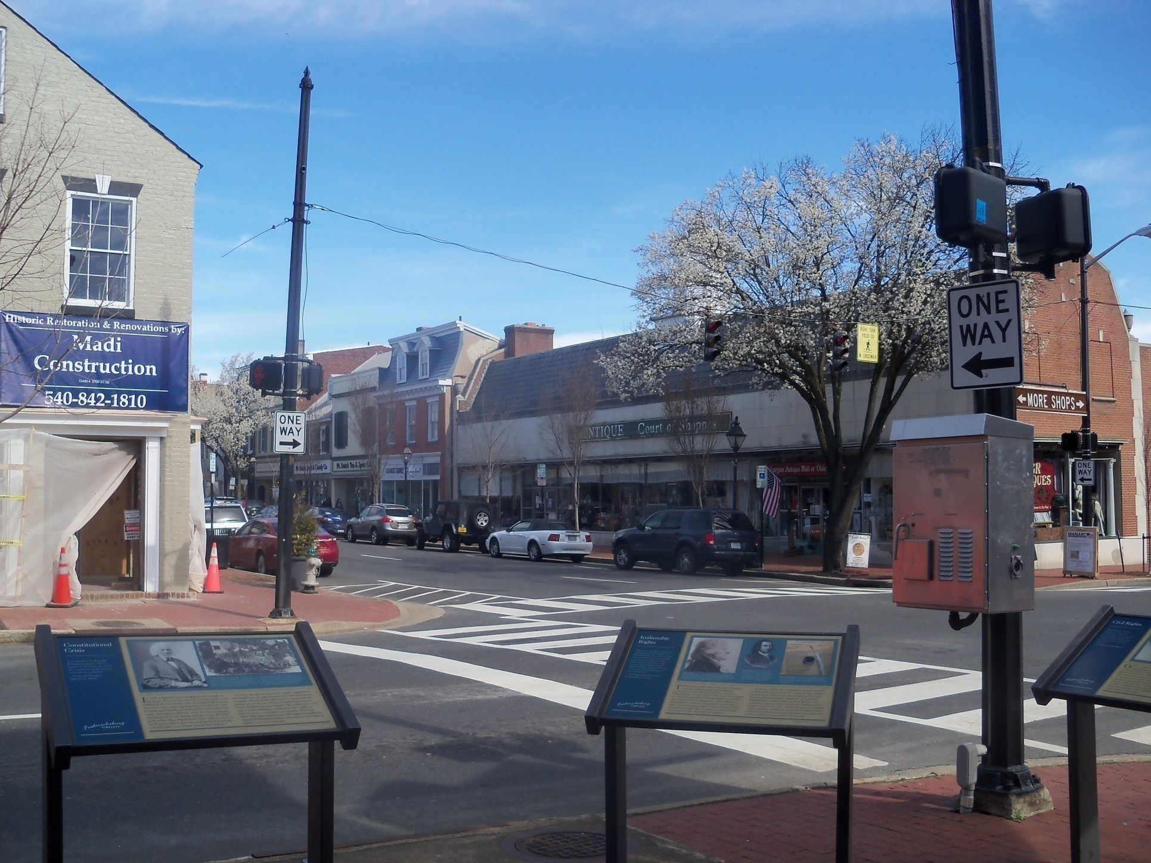
The same view today, showing the 2015 panel

Slide 12
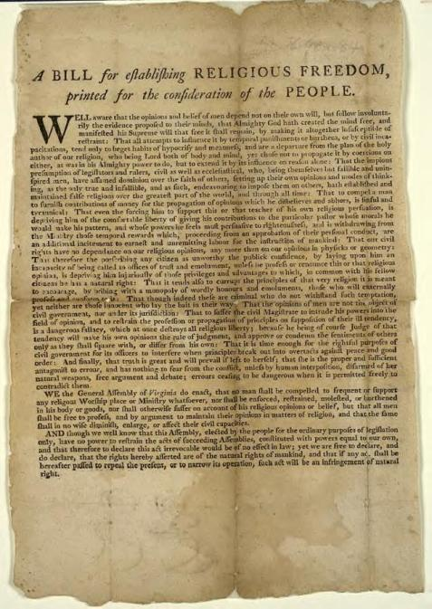
Jefferson’s Bill for Establishing Religious Freedom
Drafted 1777
First printed copy 1779
Enacted by the General Assembly 1786

Slide 13
Self-Emancipation 1862-3

Slide 14
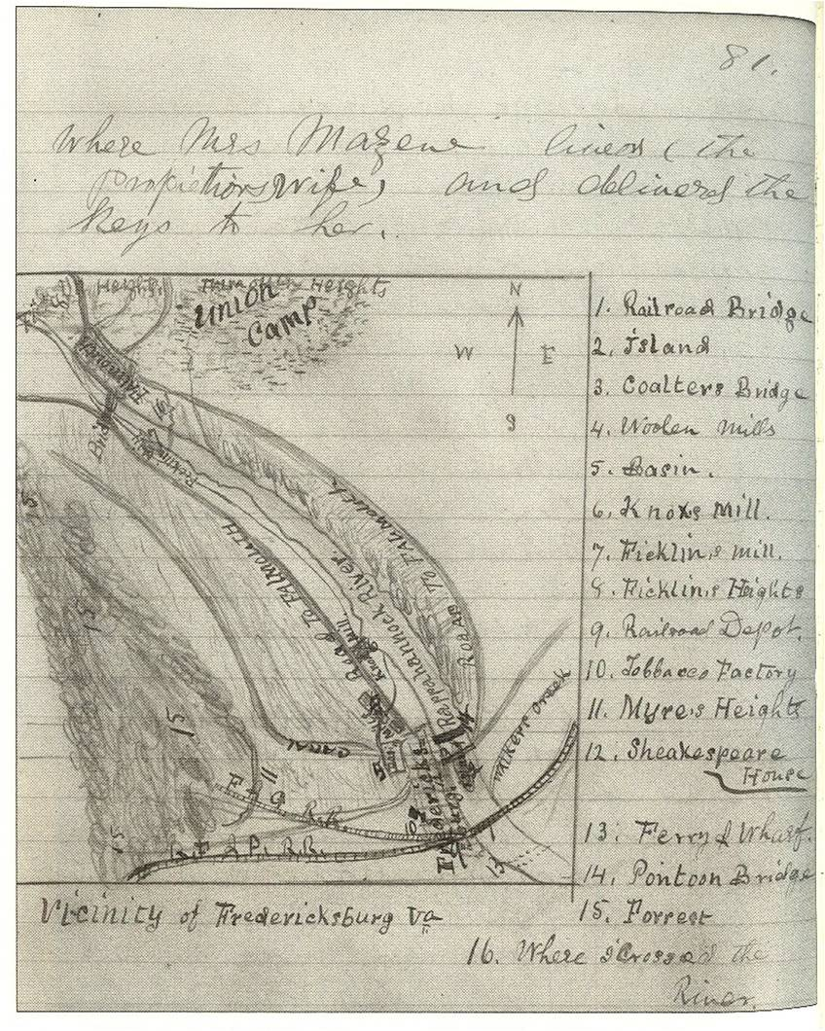
Caroline Street, the Road to Falmouth
– John Mercer Washington’s road to freedom
Three Freedoms Corner

Slide 15
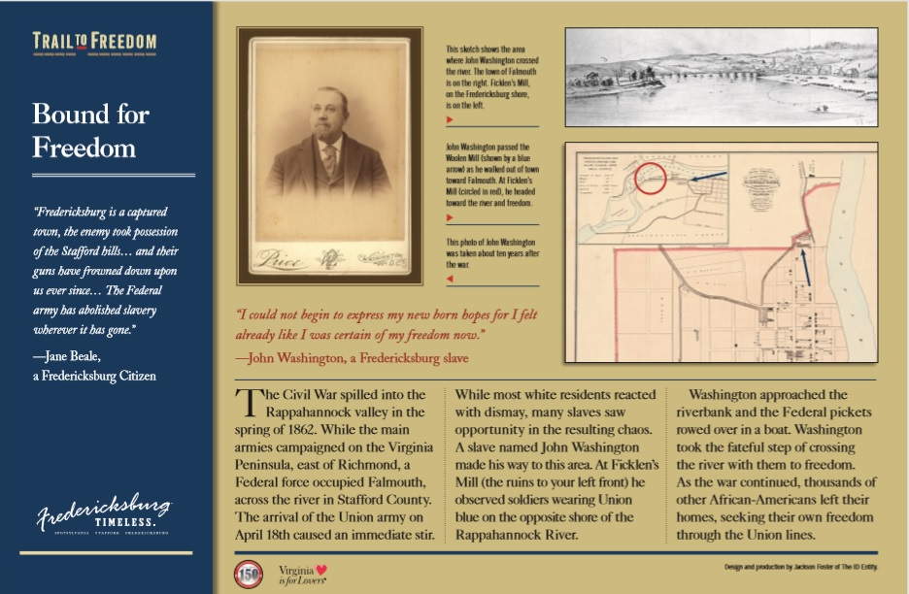

Slide 16
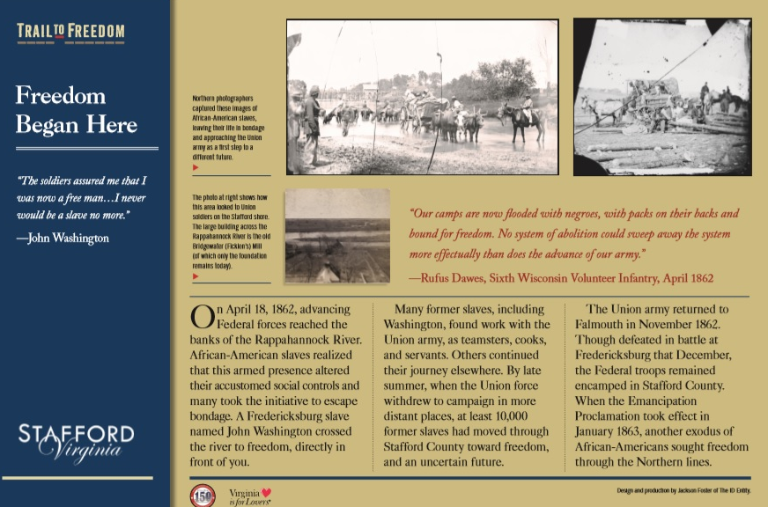

Slide 17
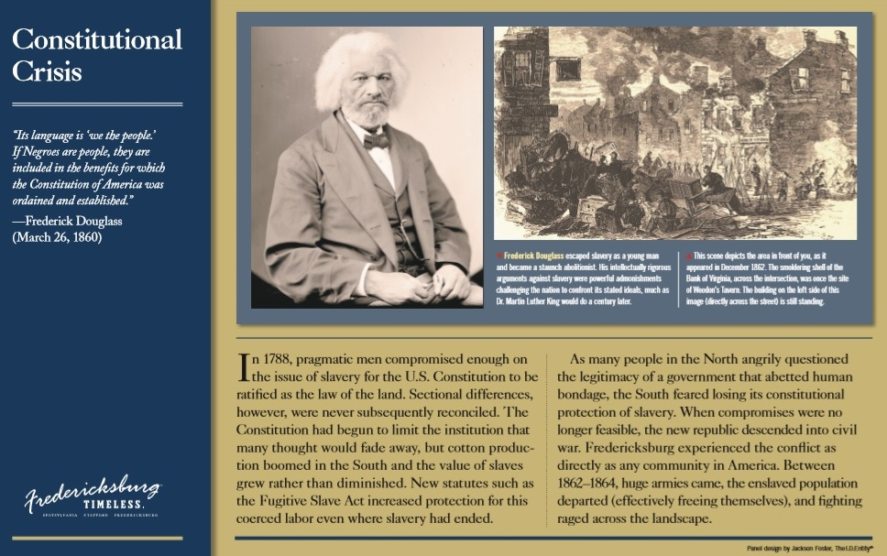
9-18-15

Slide 18
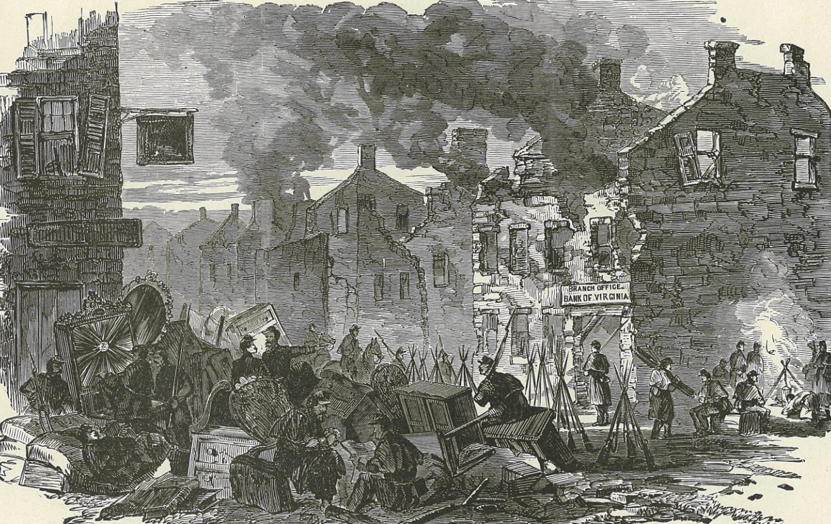
“Considering the terrible nature of the bombardment, it is wonderful that not a single inhabitant was killed by it … A fine old mansion in Main Street presented a melancholy spectacle, no less than thirty round shot having gone right through it, leaving the appearance of so many portholes. ”

Slide 19
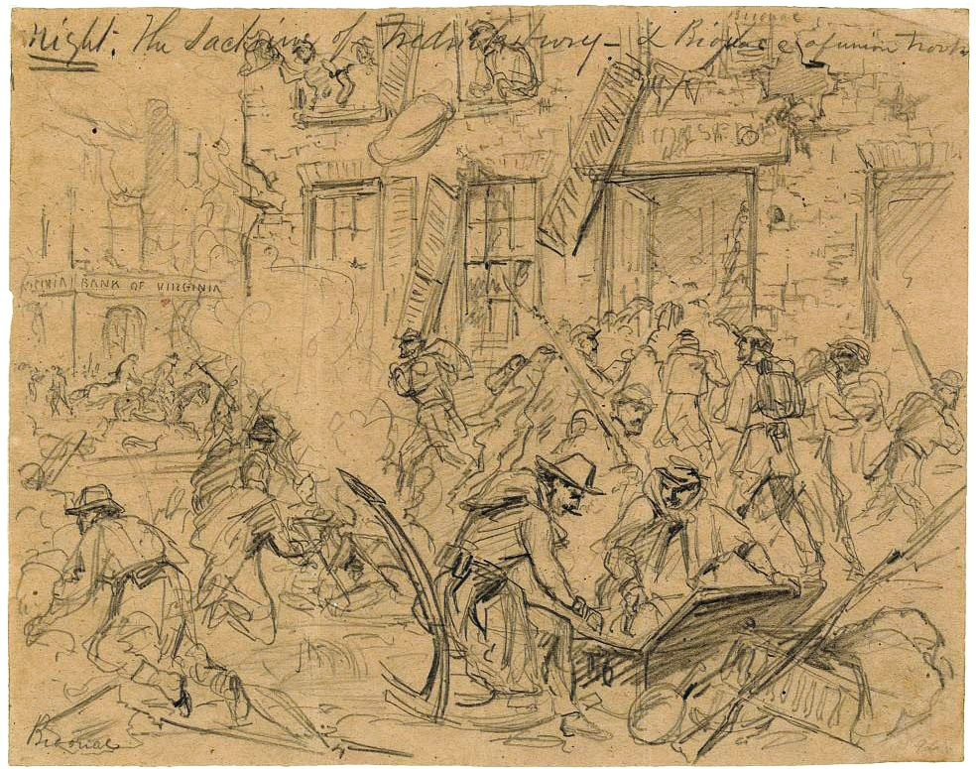
Sacking of Fredericksburg, site of Ben Franklin, William and
1000 Caroline Street, December 12 [Lumley]

Slide 20
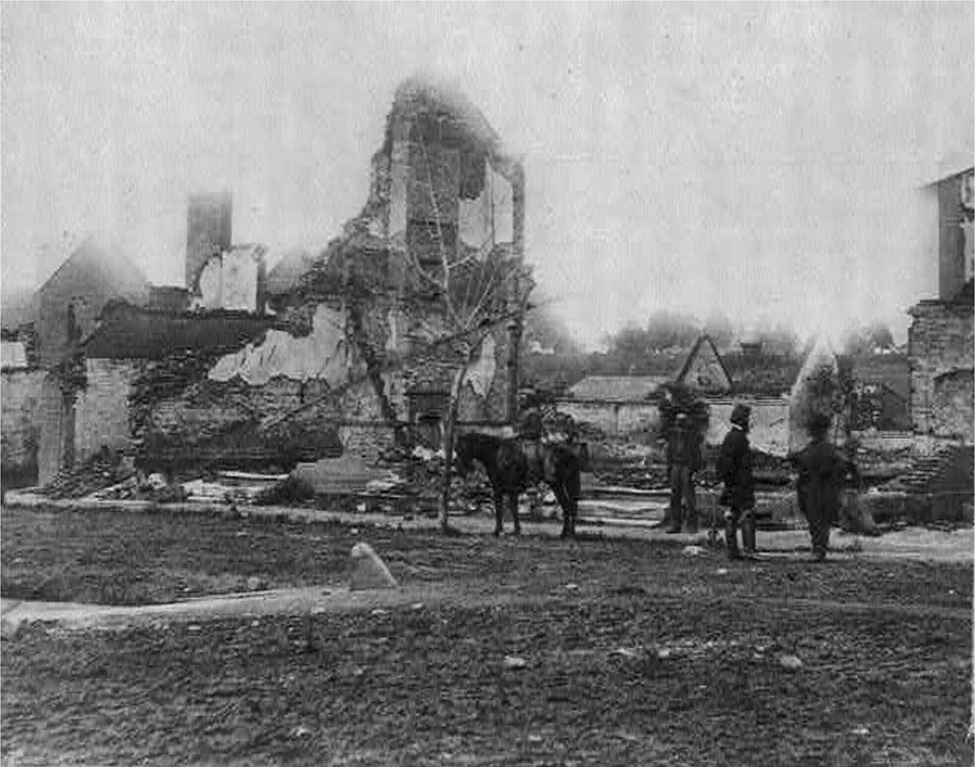
Chatham, in the background, across the river
The smoldering shell of the Bank of Virginia, once the site of Weedon’s Tavern, William and Caroline Street

Slide 21
Chatham, in the background, across the river

Slide 22
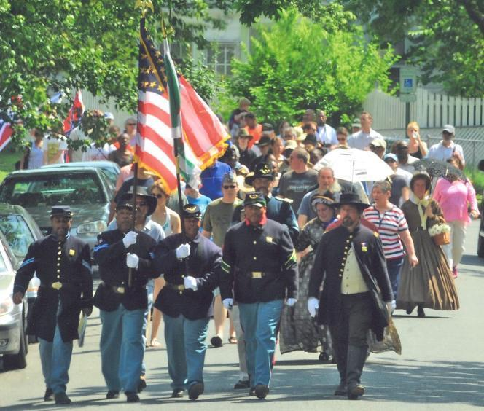
2012 23rd USCT (US Colored Troops), formed in 2011, re-enact the1871 Memorial Day parade honoring Union dead

Slide 23
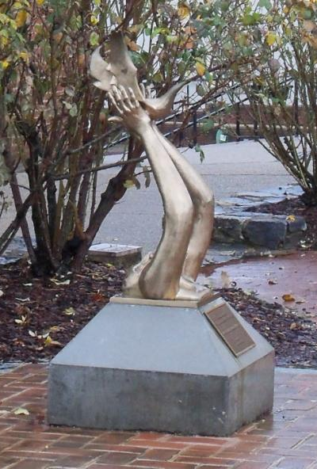
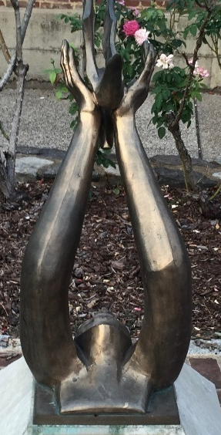
150th Anniversary of the Emancipation Proclamation
2013 sculpture by Ayokunle Odelaye
Notes:
Ayokunle Odelaye, Fredericksburg sculptor

Slide 24
Desegregation 1960

Slide 25
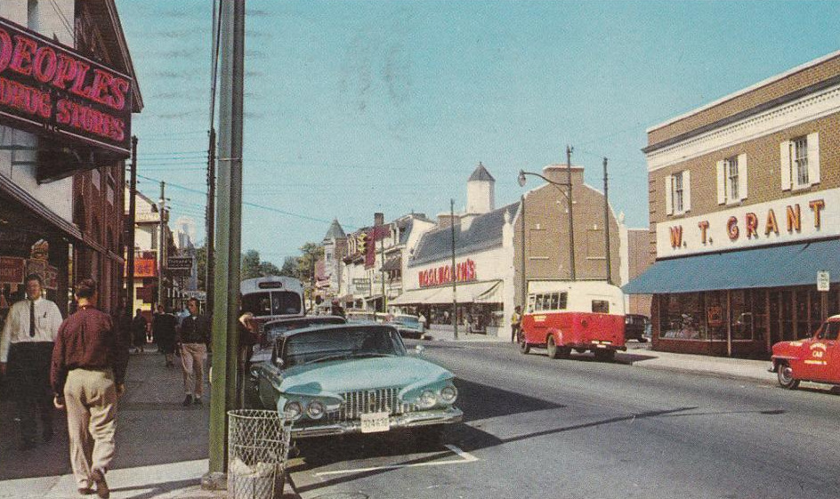
High school students desegregate lunch counters at W.T. Grant Co., Woolworth’s, and People’s, July 1960
Photo c1960

Slide 26
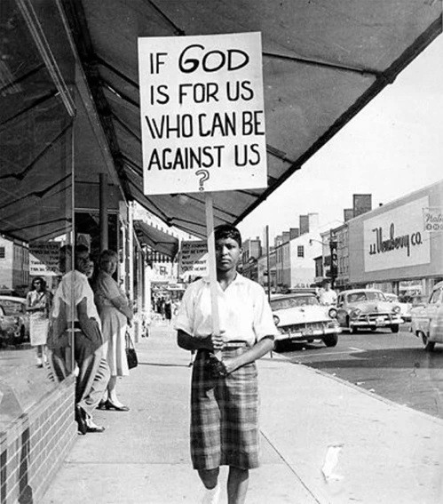
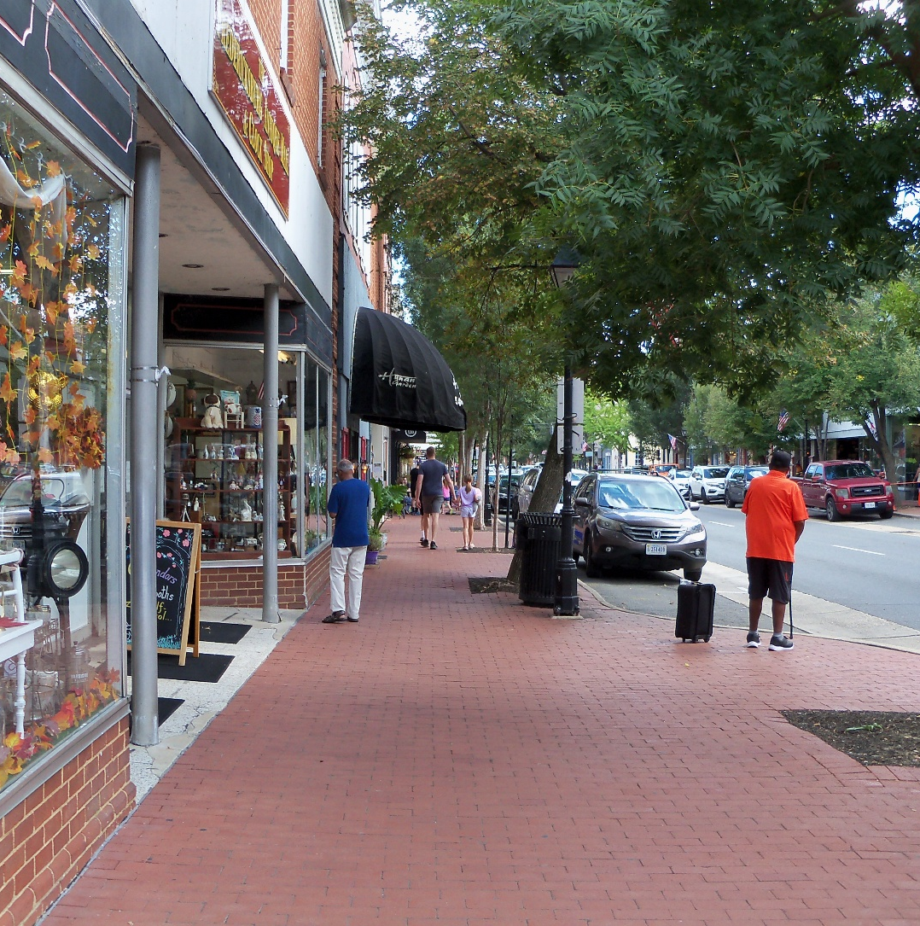
Caroline Street
Summer 2026
Jerine Mercer (McConnell) 1960
Gaye Todd (Adegbalola) in the window

Slide 27
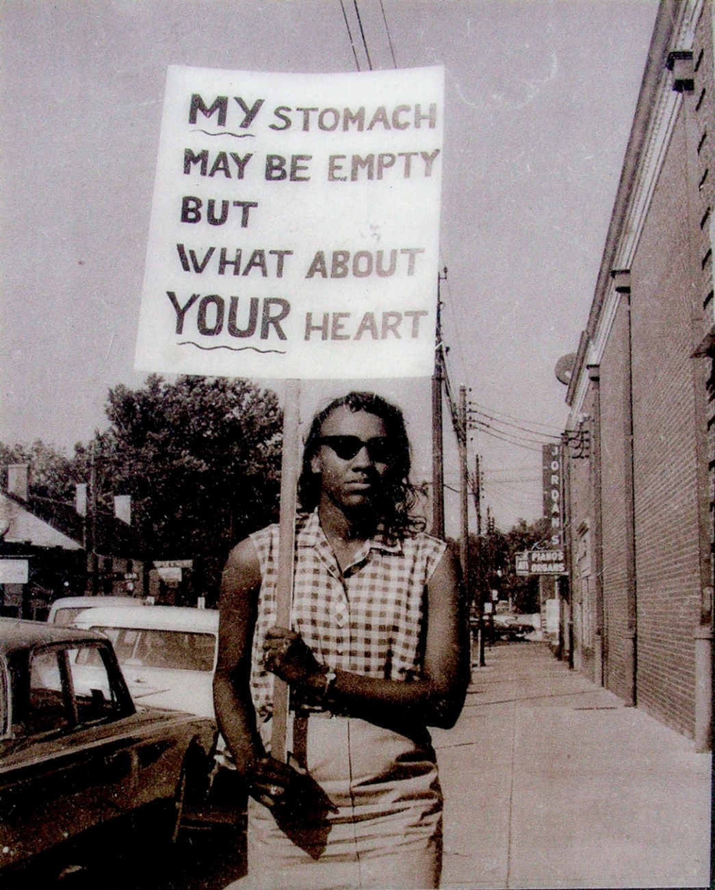
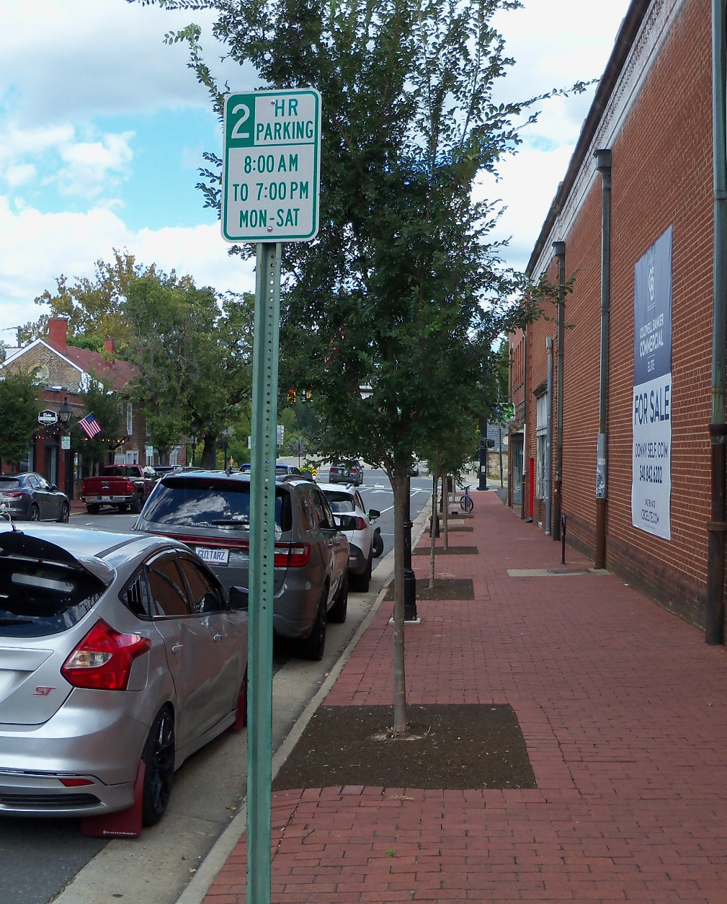
Gaye Todd (Adegbalola) 1960
William Street looking toward the Chatham Bridge

Slide 28
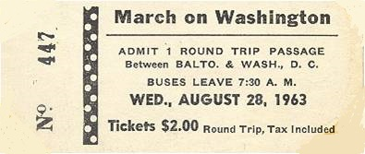
Martin Luther King’s “I Have A Dream” speech occurred just three years later

Slide 29
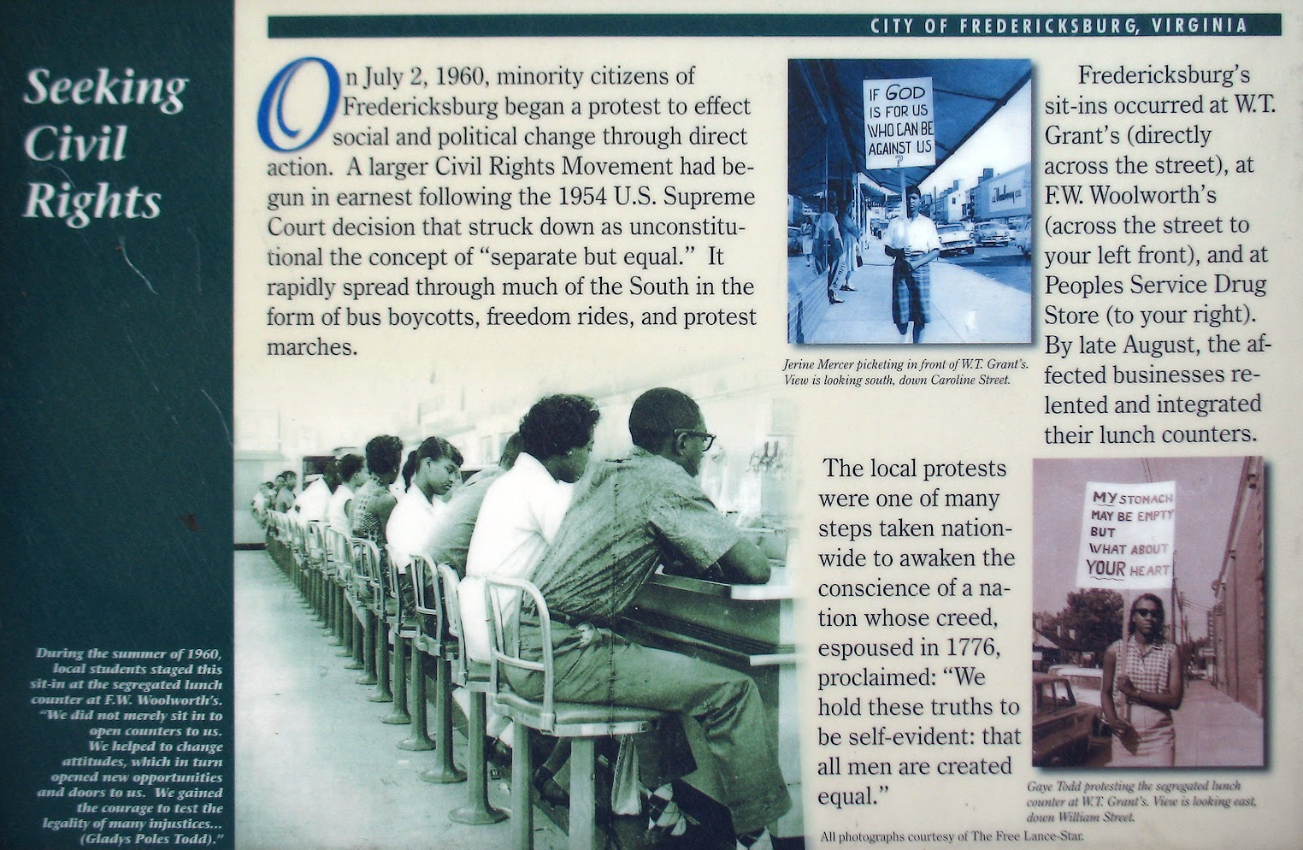
High school students desegregate lunch counters at Woolworth’s, W.T. Grant Co., and People’s Drug, July 1960 2002 plaque

Slide 30
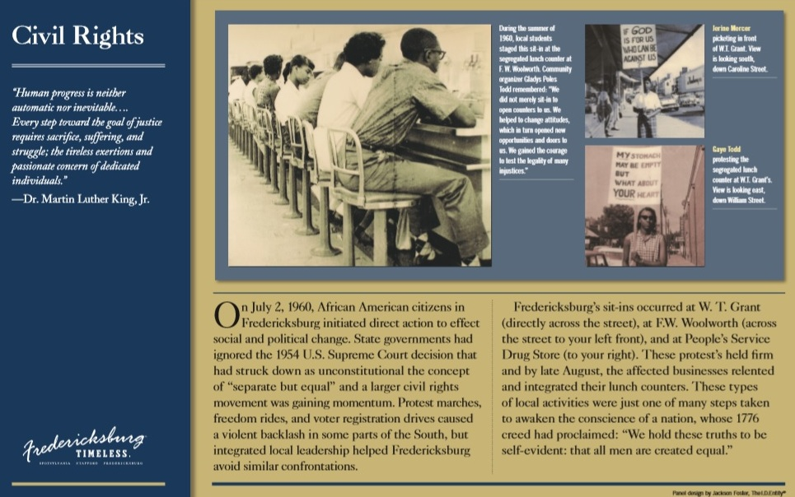
High school students desegregate lunch counters at Woolworth’s, W.T. Grant Co., and People’s Drug, July 1960 2015 plaque

